Slide 1


Fine Tune Model to retrieve custom chicken recipe
DSC670 - Advanced Uses of Generative AI
Professor: Frank Neugebauer
Project – Fine Tune GenAI Model

Slide 2



Introduction: The Power of Fine-tuning
Pre-trained AI models, developed on vast datasets, serve as a strong foundation for domain-specific fine-tuning. By customizing these models for specialized fields, businesses and researchers can enhance AI performance, ensuring it aligns with their unique requirements.
Leverage pre-trained models for specific domains
Customizing pre-trained AI with specific data enhances its expertise for industries requiring precise responses.
Improve accuracy and relevance of AI responses.
Fine-tuning creates specialized AI, improving accuracy over generic models through domain knowledge
Enable AI to understand and respond to unique data.
Fine-tuning adds proprietary knowledge to AI, enabling it to understand industry-specific data.
Example: Turning a general model into a chicken recipe specialist.

Slide 3


Project: Fine tune a Model
Fine-tune GAI, build a model using Open AI.
Overview of Fine-Tuning Steps
To customize AI for specific tasks, create a structured JSONL file, validate its format and token size, then upload it to OpenAI for fine-tuning. Monitor progress, use the fine-tuned model for inference with structured prompts, and build a Streamlit app for seamless interaction.
Step 1: Create a JSONL File
Step 2: Validate JSONL File Formats
Step 3: Check Token Size in JSONL
Step 4: Load the JSONL File
Step 5: Kickstart the Fine-Tuning Job
Step 6: Use the Fine-Tuned Model for Inference
Step 7: Use Streamlit to infer the fine tuned model as an web app

Slide 4

Step 1: Create a JSONL File
Create a JSONL with the structure as recommended for OpenAI fine tuning. The JSONL file should contain a structured conversation-style dataset for fine-tuning an OpenAI model. Each line in the file is a JSON object with a "messages" key, which stores a list of role-based messages (system, user, assistant).
System Role: Defines the assistant's behavior (e.g., "You provide chicken recipes from a given list.").
User Role: Represents a user query (e.g., "Give me a recipe for chicken Meatloaf")
Assistant Role: The AI's response, providing the recipe (e.g., "Recipe Name: Chicken Meatloaf; Ingredients: ..., Cooking Instructions: ...").
The JSONL file was manually created with custom chicken recipe names to simulate new data.
Sample JSONL line
{
"messages":
[
{"role": "system", "content": "You provide chicken recipes from a given list."},
{"role": "user", "content": "Give me a recipe for chicken Meatloaf"},
{"role": "assistant", "content": "Recipe Name: Chicken Meatloaf; Ingredients: ground chicken, onion, panko, Parmesan cheese, ...”; Cooking Instructions: Preheat the oven to 350°F, mix ingredients, bake for 50 minutes…….."}
]
}

Slide 5

Step 2: Validate JSONL File Formats
Properly formatting a JSONL (JSON Lines) file is essential for OpenAI fine-tuning. Each line must be a valid JSON object, as structural errors can disrupt the process, causing failures or interruptions. Poor formatting may lead to data being ignored or misinterpreted, resulting in incomplete training.
Following validations are done for JSONL
Each line confines to basic JSON structure, that each line in the file is a valid JSON object, validate_jsonl() function does this validation
Verify Required Roles: During parsing, ensure that only allowed roles (e.g., "user", "assistant", "system") are present. The validation script checks if the "role" field exists in each JSON object and matches the permitted values.
Validate Attributes: Ensure each role in the JSON object includes the necessary attributes, specifically the role and content key-value pairs.
The check_jsonl_formats() function processes each line, validates its structure, logs formatting issues or errors, and generates a consolidated error report.

Slide 6


Step 3: Check Token Size in JSONL
Checking token size in JSONL file is crucial for OpenAI fine-tuning
Cost Management:
OpenAI charges based on token usage. Exceeding token limits can lead to unexpected and higher costs.
Model Limitations:
Models have maximum token limits for both input and output. Data exceeding these limits will be truncated, leading to information loss and degraded performance.
Fine-Tuning Process:
OpenAI's fine-tuning process relies on accurate token counts to process your data effectively. Incorrect token counts can disrupt the training process.
How tokens are calculated
Checking token size in a JSONL file requires a tokenizer that was used in based model so that the fine tuning process.
Model Specific Tokenization : Language models are trained with a particular tokenizer. The tokenizer is an integral part of how the model understands and processes text.
Each tokenizer possesses its own vocabulary and tokenization rules. Here, "tiktoken" is primarily used by OpenAI and is employed for encoding the JSONL file.
Custom method is used to calculate the token count using ‘tiktoken’ tokenizer.
The count_tokens_for_jsonl() method iterates through each line, summing the total token count. It utilizes count_tokens_in_message_set(), which calculates the token count for each individual line.

Slide 7

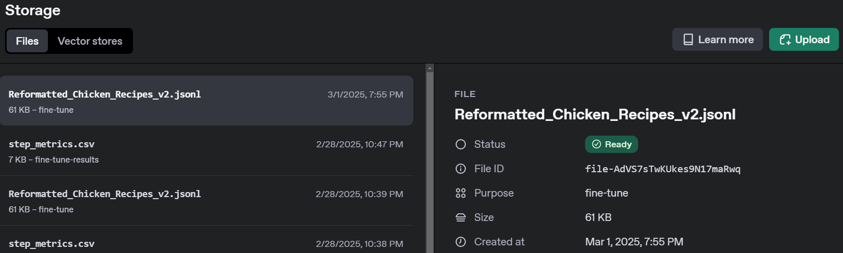
Step 4: Load the JSONL File
To fine-tune an OpenAI model, a properly formatted JSONL file must be uploaded. The parameter purpose="fine-tune" signals that the file is intended for fine-tuning.
After uploading, the file is stored and processed. If valid, it is marked as "Ready" for fine-tuning; otherwise, errors result in a "Failed" status. A file ID is provided for reference.
openai API is used to load the file, “OpenAI” class acts as the client to interact with chosen model for fine tuning
The OpenAI.files.create() method, part of the OpenAI class, uploads the JSONL file by taking two parameters: the file path and purpose="fine-tune", indicating its use for fine-tuning.
create() method returns a file-id and the same can be used when invoking fine-tuning
A sample status in OpenAI dashboard after uploading a JSONL file

Slide 8

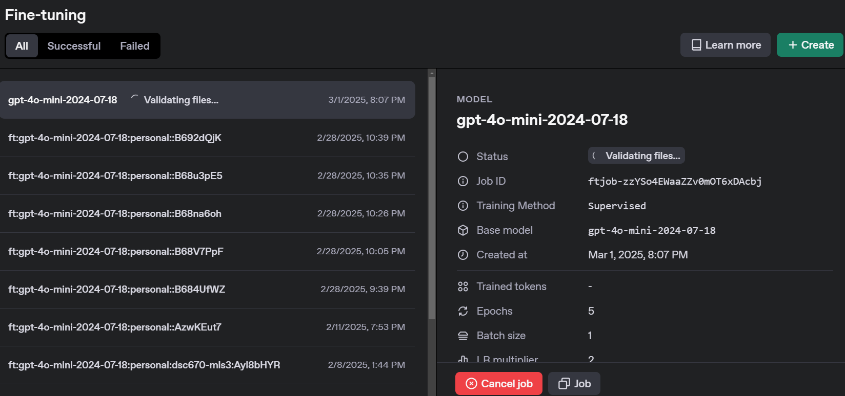
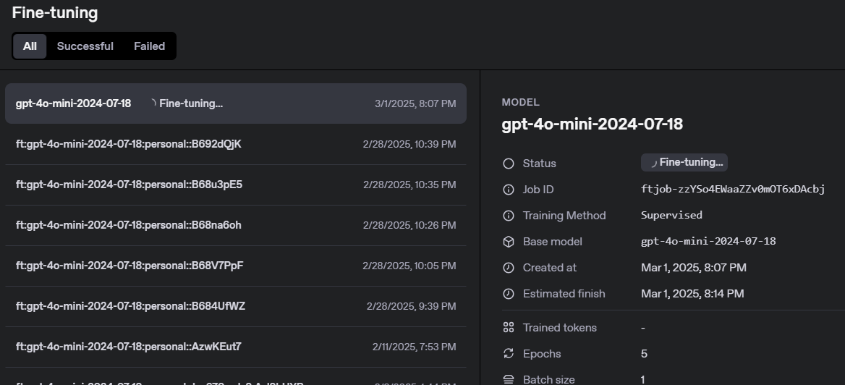
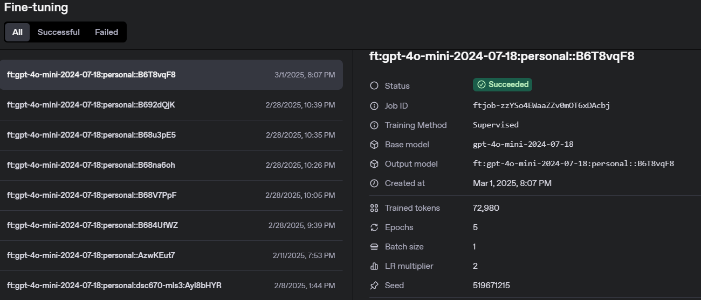
Step 5: Kickstart the Fine-Tuning Job
Initiate the fine-tuning process via the OpenAI API using the file ID from the uploaded JSONL and specify the base model for fine-tuning. For this project, the gpt-4o-mini-2024-07-18 base model is used.
This process generates a job ID, which can be used to track the fine-tuning status..
The process begins with training file validation, after which it is queued for fine-tuning, awaiting resource availability. OpenAI.fine_tuning.jobs.create() with 3 parameters like file id (uploaded file reference), model name and hyperparameters
Once fine-tuning begins, querying the API, OpenAI.fine_tuning.jobs.retrieve() returns a "running" status under "Fine-tuning". Upon successful completion, the status updates to "succeeded", providing the fine-tuned model ID.
Screenshots from the OpenAI dashboard illustrate the fine-tuning process as it progresses through various stages and status updates.

Slide 9

Step 6: Use the Fine-Tuned Model for Inference
Once fine-tuned model is trained and available, it can be used for inference, meaning it can generate responses based on the model’s knowledge.
The inferred prompt or message will use the JSNOL structure, system role and user role with attributes as content. The user role content will include the prompt question and system role will instruct the model.
The user prompt is prefixed with system prompt to build a consolidated prompt. user_content variable contains the user prompt
OpenAI.chat.completions.create() method is used to infer the fine tunes model that receives the model id (fine tuned model id) and the consolidated prompt message.
Sample consolidated prompt message included in the method call
The returned response contains a object ChatCompletionMessage
ChatCompletionMessage(content=<<Recipe details>>, refusal=None, role='assistant', audio=None, function_call=None, tool_calls=None)
Since the attribute in interest is content, its value which is the chicken recipe is retrieved and printed or displayed
messages=[
{"role": "system", "content": "You being a great chef provide chicken recipes from the finetuned model only"},
{"role": "user", "content": user_content}

Slide 10

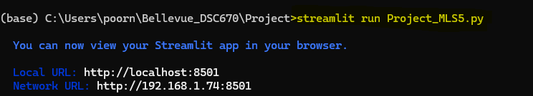
Streamlit web app
Streamlit is an open-source Python framework designed for creating interactive web applications, particularly for data science, machine learning, and AI-based projects. It allows developers to build and deploy powerful web applications with minimal code.
Its features
Write a Python script, and Streamlit automatically turns it into an interactive web app.
Any Changes in user input, updates the UI dynamically without requiring page refresh.
From bash or command line execute the command >> streamlit run Project_MLS5.py

Slide 11
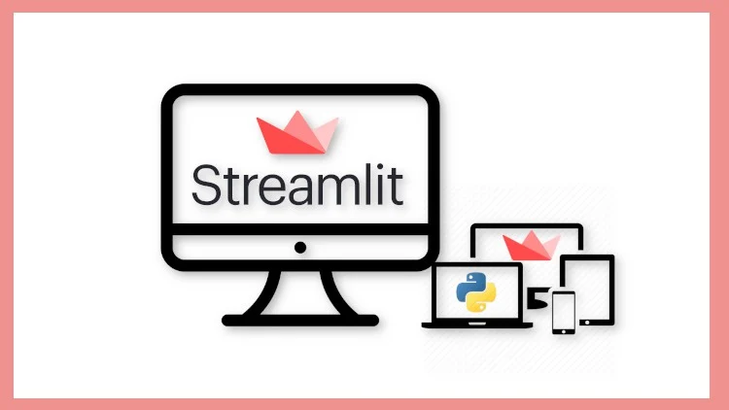
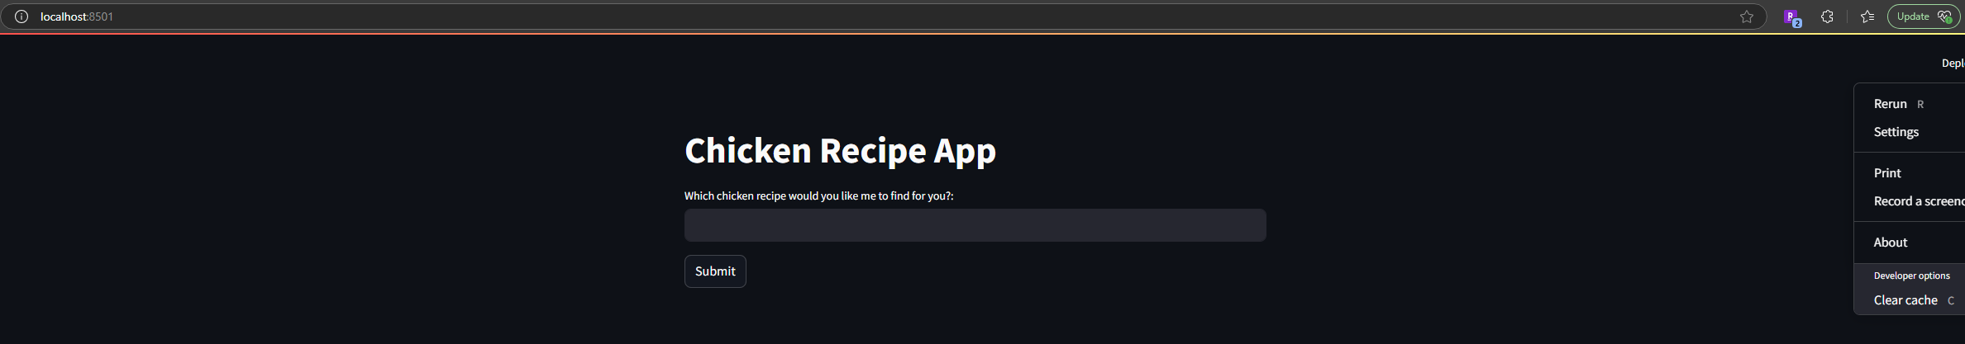
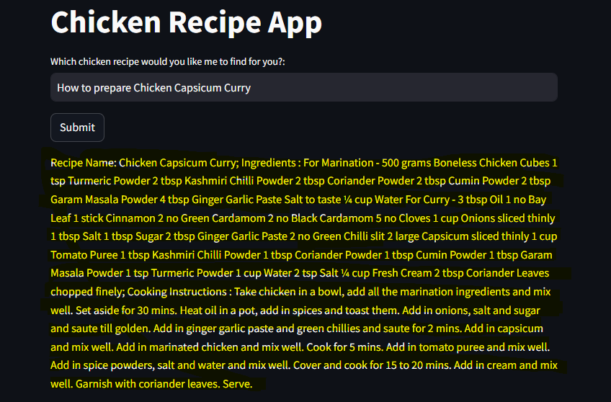
Streamlit web app – Contd..
Streamlit API is used and a title “Chicken Recipe App” is set and a text input with a label “Which chicken recipe would you like me to find for you?: is set . The API provides a submit button for user to confirm the input.
A python script that uses the inference method as detailed in slide 9 - Step 6: Use the Fine-Tuned Model for Inference is invoked when the user fills the text box with prompt message (in this case requesting a particular chicken recipe) and clicks “Submit” button.
The response from inference is displayed below the submit button

Slide 12


